Slide 1

Employee Attrition Analysis
Made by
Prachi Mehta

Slide 2


Problem Statement
XYZ company which was established a few years back is facing around a 15% attrition rate for a couple of years. And it's majorly affecting the company in many aspects. The task is to understand why employees are leaving the company and then provide solutions that can reduce the attrition rate and help the company succeed.
Software Used:
Tableau Public

Slide 3

Dataset
Total Records: The dataset contains information on a total of 4,410 employees.
Key Variables:
Demographics – Age, Gender, Marital Status
Job Details – Job Role, Department, Years at Company, Years Since Last Promotion, Performance Rating
Compensation – Monthly Salary, Percent Salary Hike, Stock Option Level
Engagement – Job Satisfaction, Work-Life Balance, Environment Satisfaction
Attrition – Attrition Status (Yes/No)
The dataset helps to analyze the patterns and factors contributing to employee attrition within the organization.

Slide 4

Data Cleaning
The data cleaning process is been done using MS Excel. The steps taken for data cleaning are:
The first step taken to ensure the reliability and accuracy of the dataset was to identify and remove the duplicates to ensure each record is unique.
Removed the unwanted columns like Over18 and StandardHours as they contained the same value for the entire dataset and therefore did not add any analytical value.
To handle the missing values, calculated the median values for relevant columns and filled the missing data to ensure consistency without impacting the results.
Created new columns to replace the numeric codes with meaningful labels to enhance the readability and analysis. For eg – transformed the education column from numeric values to descriptive labels.
Created new columns to categorize the data such as grouping age into age groups, monthly income into income ranges, etc. to get more insightful analysis

Slide 5
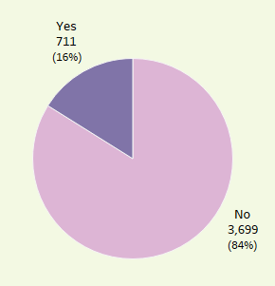
Overall Attrition Rate
Out of a total of 4,410 employees, 711 employees left the organization which has resulted in an overall attrition rate of 16%.
This means that 16% of the workforce or 711 employees have left the organization during the period leaving 3,699 as active employees.
A 16% attrition rate indicates that the organization may face challenges related to employee retention that can impact productivity, morale, and operational continuity.

Slide 6
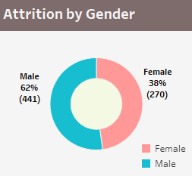
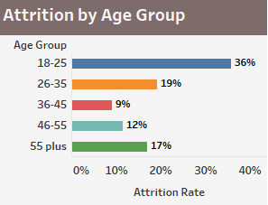
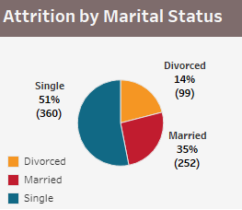
Attrition by Demographics
Age Group:
The highest attrition of 36% was found between the age group of 18-25 years which are early-career employees due to challenges faced in job satisfaction or growth opportunities.
Marital Status:
The majority of employees who left the organization were single. As single employees have fewer personal and family responsibilities, they are more likely to explore new career opportunities.
Gender:
Male employees tend to leave the organization as compared to female employees.

Slide 7
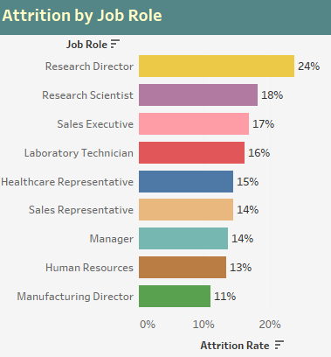
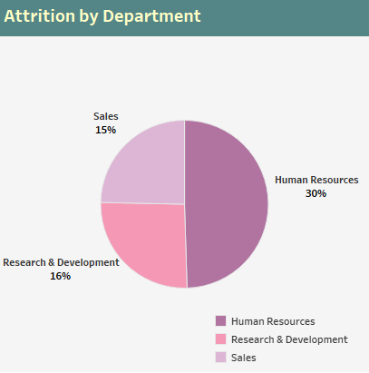
Attrition by Job Role & Department
Based on my analysis, the highest attrition rates are found to be in the human resources department (30%) and research director role (24%) which needs immediate attention to understand and address the underlying issues.
The sales department and sales executive role shows a consistent attrition rate of 15-17%.
The Research & Development department faces an attrition rate of 16% whereas research scientist and laboratory technician roles also face the same turnover.
We need to plan targeted retention strategies, particularly for senior research roles and HR personnel.

Slide 8
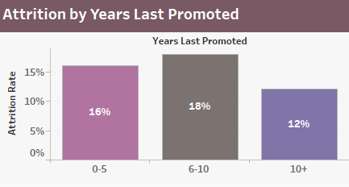
Attrition by Years Since Last Promoted
A moderate attrition rate of 16% was shown for the employees who have been promoted within the last 0-5 years which remains consistent with the overall company rate.
A higher attrition rate of 18% was shown for the employees who have gone 6-10 years since their last promotion which may be due to stagnation or lack of career advancement.
The employees who have gone 10+ years since their last promotion showed the lowest attrition rate of 12% which interprets that employees are more committed towards their work despite the fewer promotions.

Slide 9
Correlation Analysis
Younger employees between the age group of 18-25 years are more likely to leave the company than those above 25 years, who are less likely to leave.
Employees who earn a monthly income between 10k to 20k are more likely to leave as compared to those whose salary is high and are less likely to leave the organization.
Higher job satisfaction results in lower attrition whereas dissatisfaction increases the chances of leaving.
Early-career employees who have been with the company for 0-10 years are more likely to leave the organization as compared to those who have been more than 10 years are more likely to stay in the organization.
Employees who travel frequently are more likely to leave the organization probably due to work-life balance challenges and job dissatisfaction.

Slide 10

Recommendations
Implement career development and mentorship programs to enhance the retention of younger employees between the age group of 18-25 years.
Increase compensation for lower-income employees by reviewing and adjusting for employees who are earning between 10k to 20k.
Increase job satisfaction by regularly assessing and addressing job satisfaction factors by focusing on engagement and recognition.
Supporting early-career employees by providing clear growth opportunities and onboarding support to employees who have been in the company for 0-10 years.
To reduce the travel burden, we can offer flexible travel policies or support programs to employees who travel frequently for work.

Slide 11
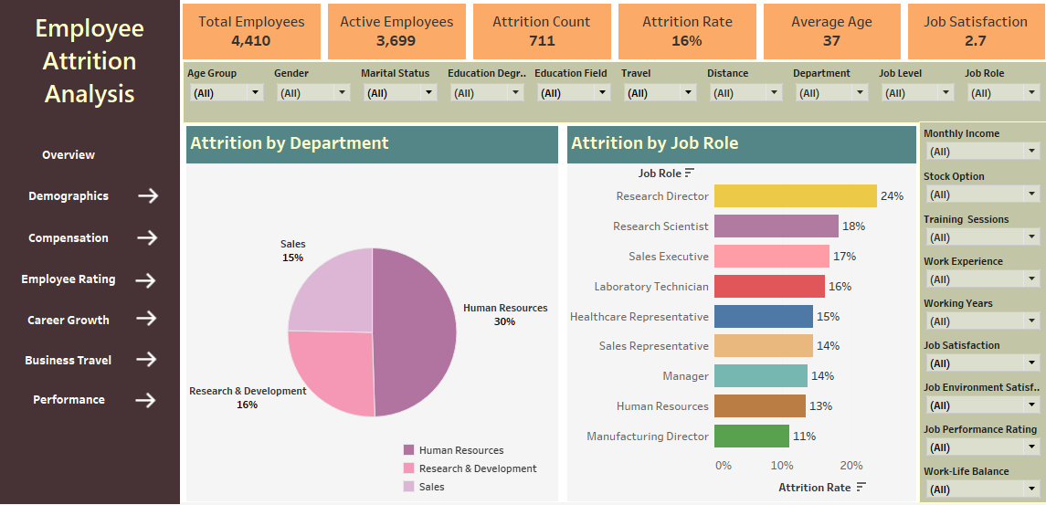
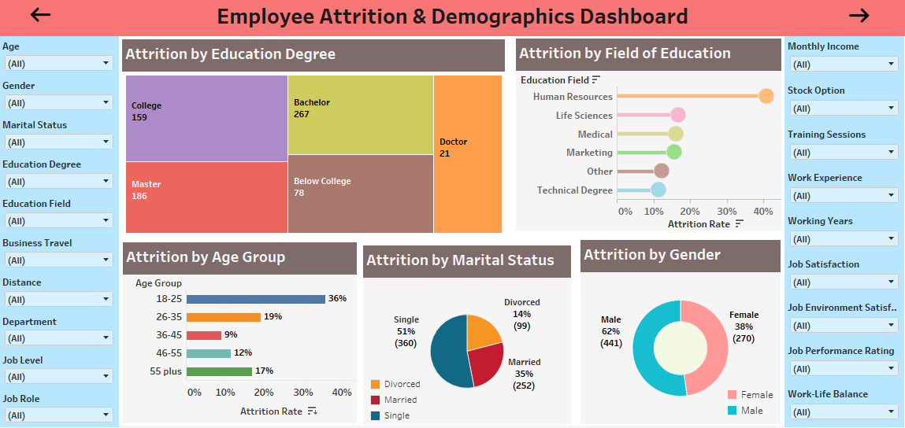
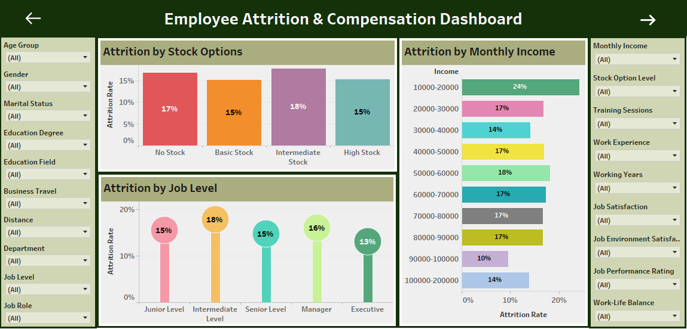
Dashboard Designs

Slide 12
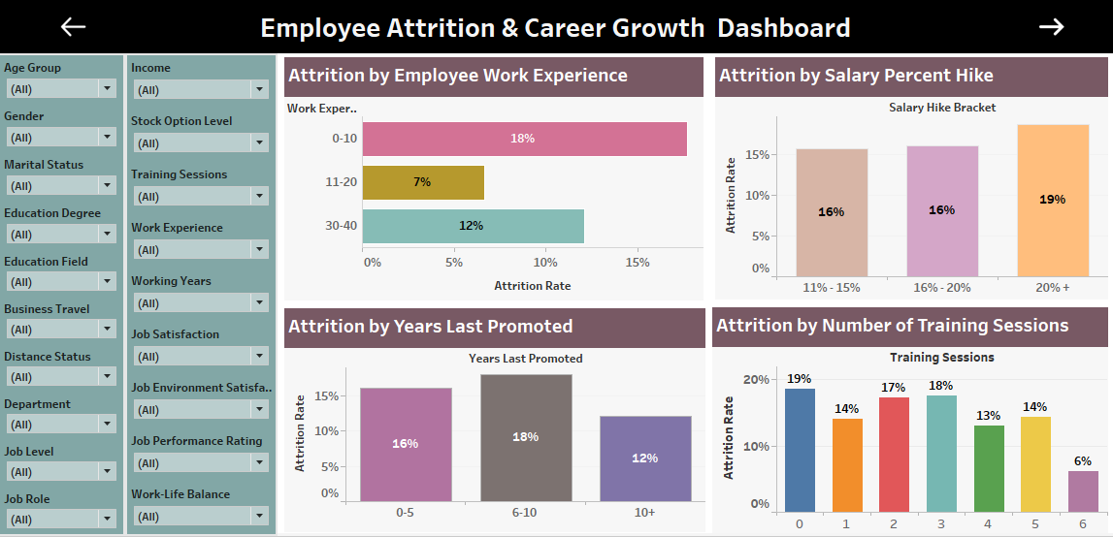
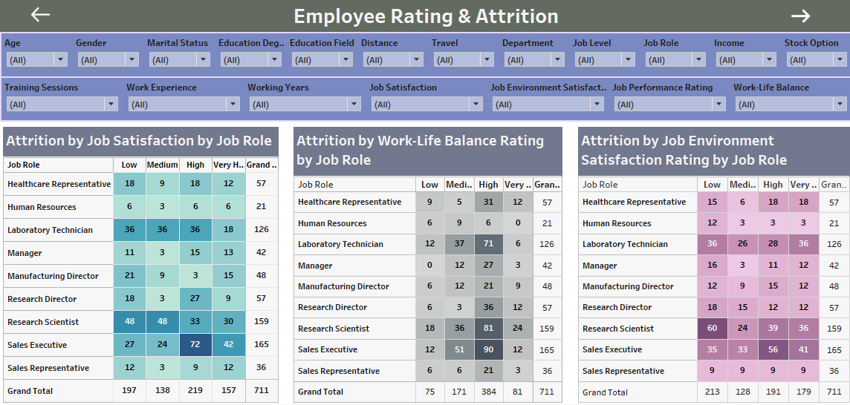
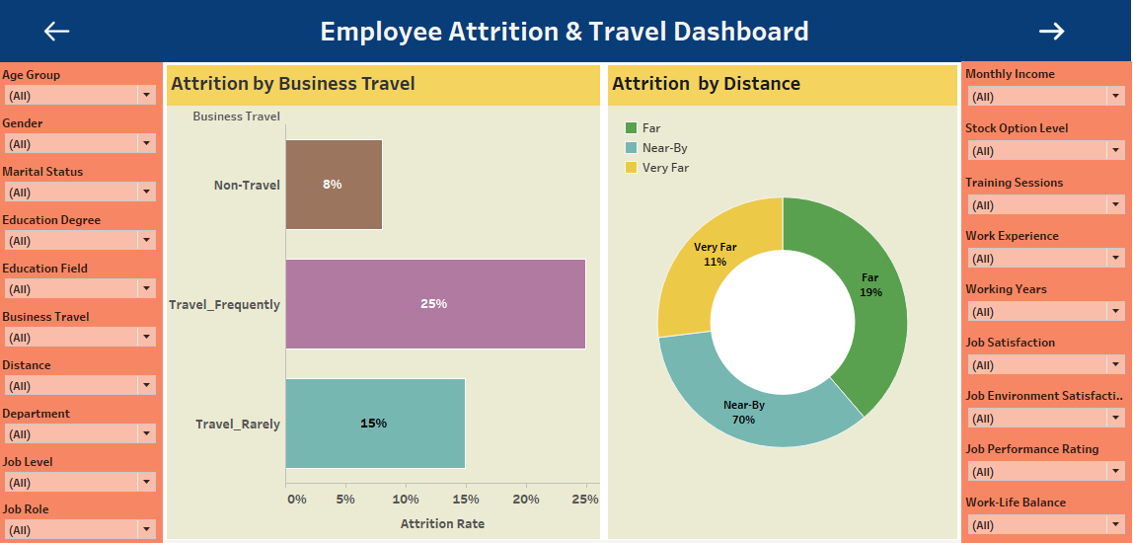
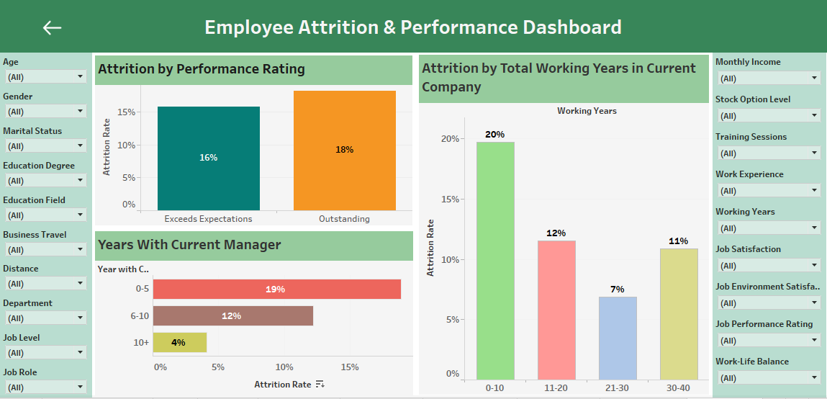

Slide 13

Thank You
Project Link
https://public.tableau.com/views/Employee_Attrition_Analysis_17220799199530/Overview?:language=enUS&publish=yes&:sid=&:redirect=auth&:display_count=n&:origin=viz_share_link

